Slide 1
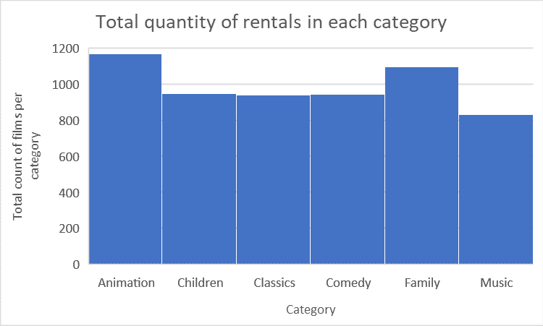
How many family friendly films are rented?
We see that animation films are rented the most, and music the least. Although there is an even spread.

Slide 2
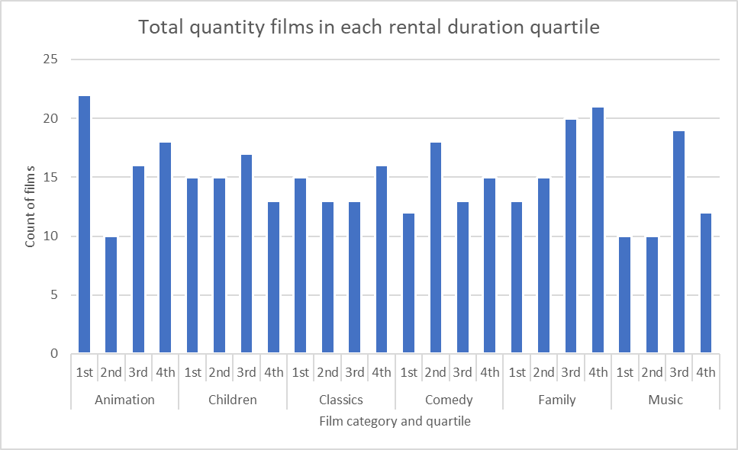
What is the spread of rental duration for family friendly films?
We see that family friendly films have quite an even spread of duration. Animation films tend to be rented for the shortest period of time, whilst family films are more likely to be longer.
These duration quartiles are taken from data for all rental films, not just the categories shown here.

Slide 3
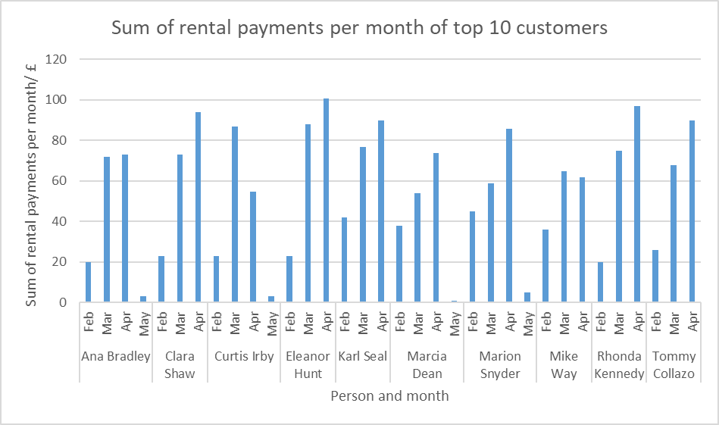
What is the spending pattern of the top 10 customers?
Note, data was only available for the 2nd half of February and the 1st half of May.
We see that there was a trend to watch more films in March and April, perhaps over Easter holidays. This trend does not seem to have continued into May though.

Slide 4
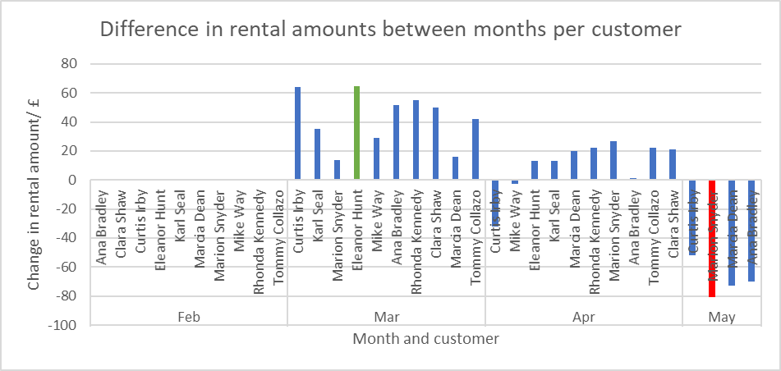
What is the difference in rental amounts between months?
This reiterates the previous slide, showing an increase in rental amount for March and April before a sharp decline in May (even when considering the data is only available for the 1st half of April)
Largest increase is shown in green and is Eleanor Hunt
Largest decrease is shown in red and is Marion Snyder

